Slide 1
Spotify Trend Analysis
File created on: 6/24/2023 4:03:00 PM

Slide 2
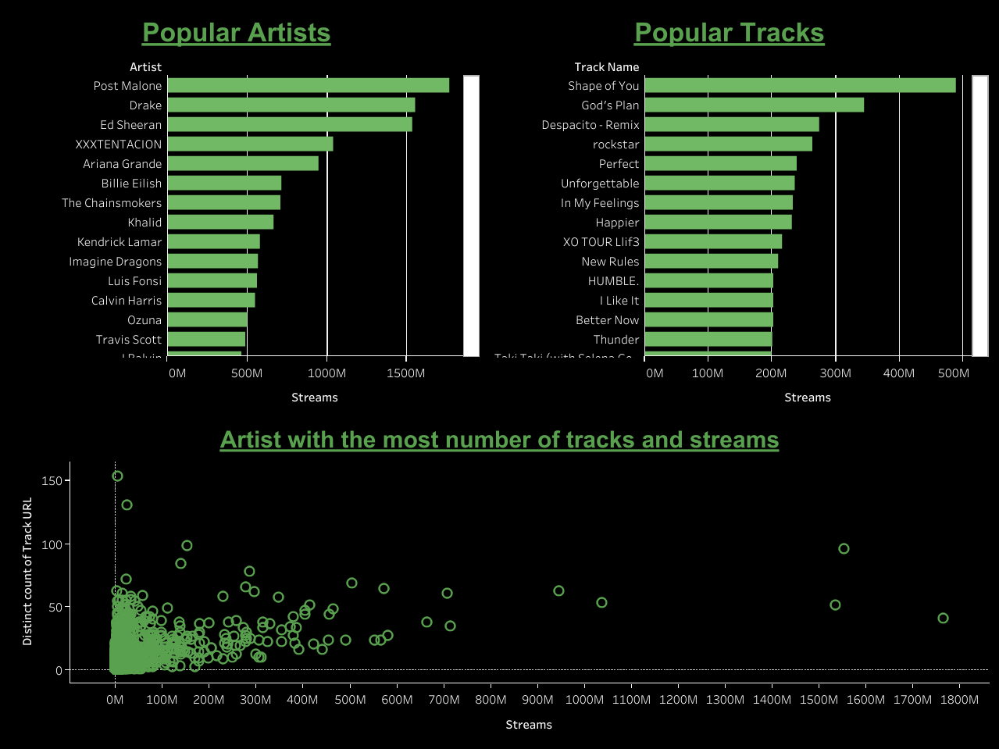

Slide 3
